Slide 1

Indoor Air Quality Monitoring & Automation System
Submitted To : Prof. Lava Bhargava

Slide 2
Common Air Quality Related Problems & Smart Solutions
1. Mold Growth
o Cause: High humidity, poor airflow
o Impact: Allergies, damage
o Fix: Humidity sensor + auto dehumidifier/fan
2. Stale Air / Poor Circulation
o Cause: Closed spaces
o Impact: Drowsiness, CO₂ buildup
o Fix: CO₂ sensor + auto exhaust/window
3. VOC Accumulation
o Cause: Chemicals, cleaners
o Impact: Headaches, irritation
o Fix: VOC sensor (e.g., MQ135) + purifier
4. Temperature-Sensitive Storage
o Cause: Temp fluctuations
o Impact: Spoilage, malfunction
o Fix: Temp sensor + auto AC/fan/heater
5. Dust & Particulates (PM2.5/PM10)
o Cause: Poor sealing/filtering
o Impact: Respiratory risks
o Fix: PM sensor + air filter activation
6. CO₂ Accumulation
o Cause: Poor ventilation in crowded rooms
o Impact: Fatigue, low focus
o Fix: CO₂ sensor + smart ventilation

Slide 3
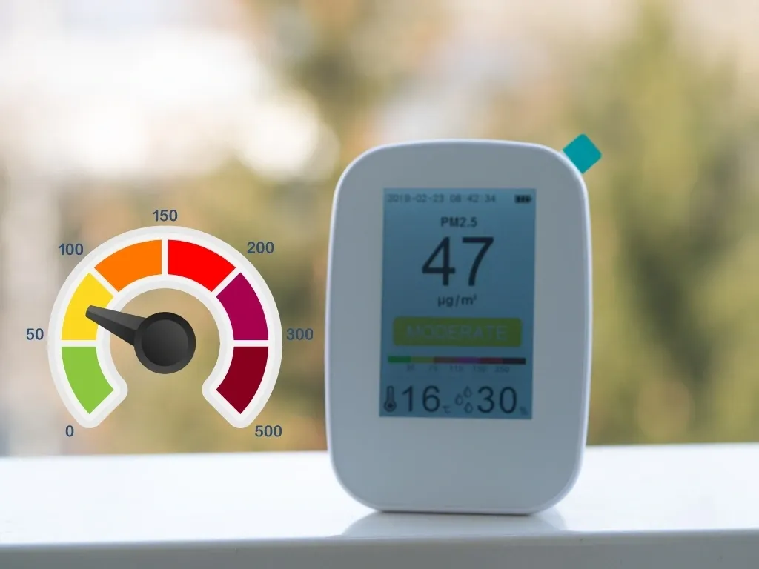
Project Objective
To develop a system that:
Monitors indoor air quality in real-time
Alerts users when air quality drops
Automatically controls devices like exhaust fans, air purifiers, or windows

Slide 4
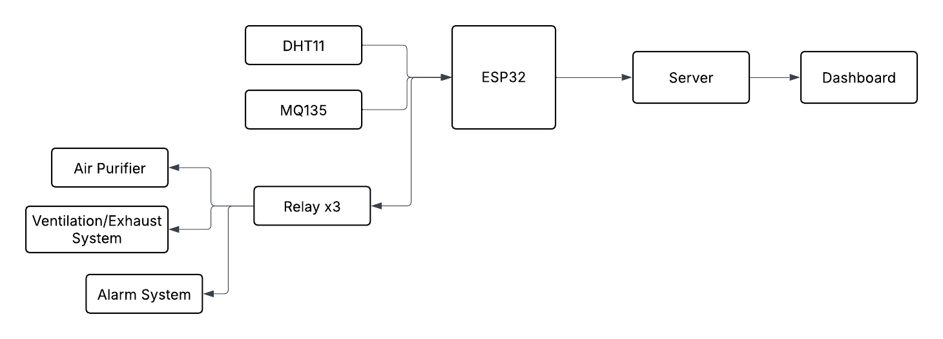
System Architecture
Sensors: Collect environmental data (e.g., temperature, humidity).
ESP32: Sends sensor data to Mosquitto MQTT broker.
Actuators: ESP32 activates devices (e.g., fans, valves) based on environmental conditions.
Dashboard: Displays real-time data and system status via REST API.
Feedback Loop: Continuous monitoring and adjustment of the environment.

Slide 5
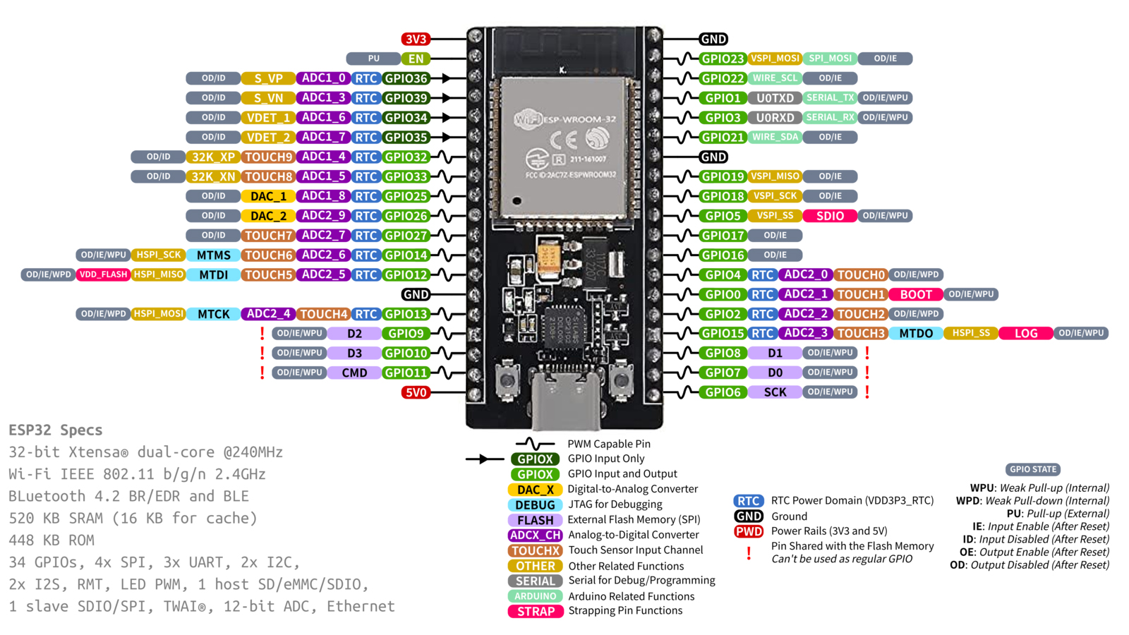
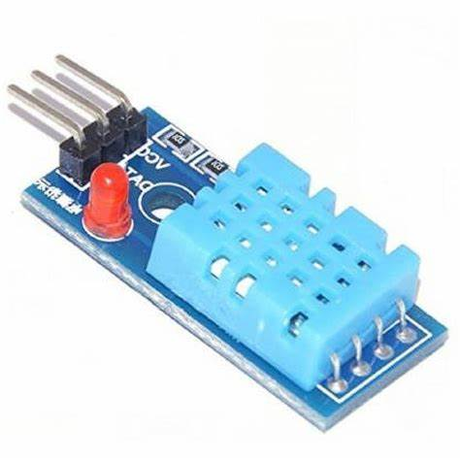
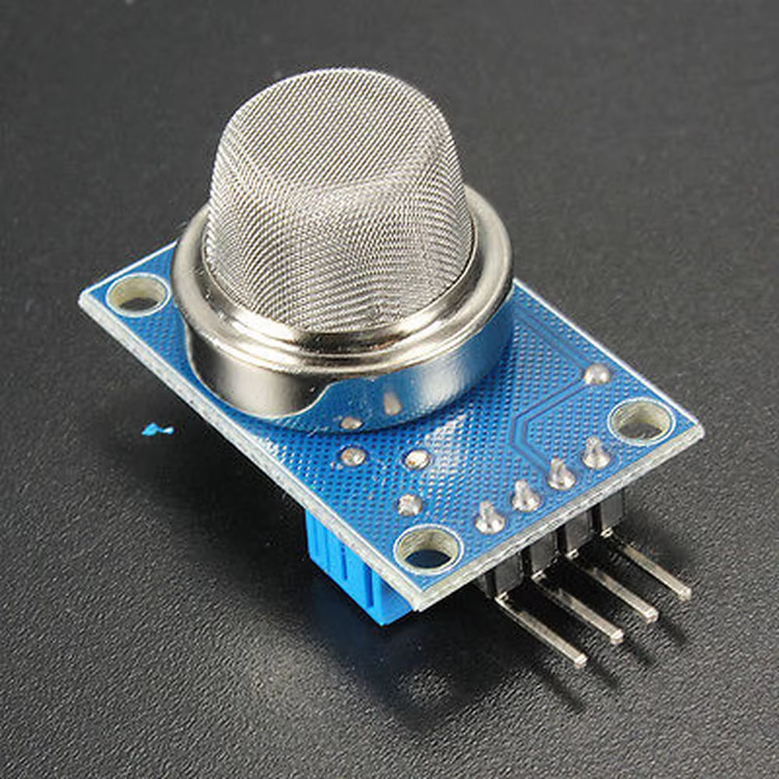
Hardware Components
ESP32 - Microcontroller
DHT 11 - Temperature & Humidity Sensor
MQ135 Sensor - Smoke, Gas & AQI Sensor
Relays - ElectroMagnetic Switches to Control AC Appliances using DC Supply

Slide 6

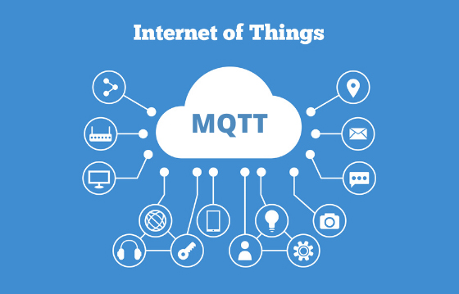
Software Used
Arduino IDE - Programming ESP32
Python - Rest APIs
Eclipse Mosquitto - Mqtt Protocol Broker
HTML/CSS/JS - Web Dashboard

Slide 7
MQTT Protocol
Lightweight & Efficient
Designed for low-bandwidth, low-power devices; ideal for IoT applications using microcontrollers like ESP32.
Publish/Subscribe Model
Devices (clients) publish data to topics; other devices subscribe to those topics to receive updates asynchronously.
Broker-Based Communication
A central MQTT broker (e.g., Eclipse Mosquitto) manages all message routing between publishers and subscribers.
Quality of Service (QoS) Levels
Offers 3 levels of message delivery assurance:
QoS 0: At most once (no guarantee)
QoS 1: At least once
QoS 2: Exactly once
Light Overhead & Real-Time Messaging
Uses minimal headers and supports real-time communication with low latency, making it ideal for sensor data and control signals.

Slide 8
Future Scope
Add more accurate sensors (e.g., BME280, MQ2, DHT22).
Develop a mobile app for remote monitoring/control.
Integrate with cloud MQTT brokers (e.g., AWS IoT, Adafruit IO).
Use machine learning models (ANN, RNN, LSTM )for predictive appliance control.
Add voice control via Google Assistant/Alexa.
Implement alerts/notifications (SMS, email, push).

Slide 9
References
Indoor Air Quality Monitoring & Automatic Ventilation System
Forecasting Energy Consumption using AI
Energy Efficient Control Methods For HVAC Systems
Indoor Air Quality Monitoring & Controlling System based on IOT & Fuzzy System
Intelligent Edge: AI & ML in Edge Computing
AI-Driven Edge Computing
Intelligent HVAC System
Review of Energy Efficient HVAC Technologies For Sustainable Buildings

